Slide 1

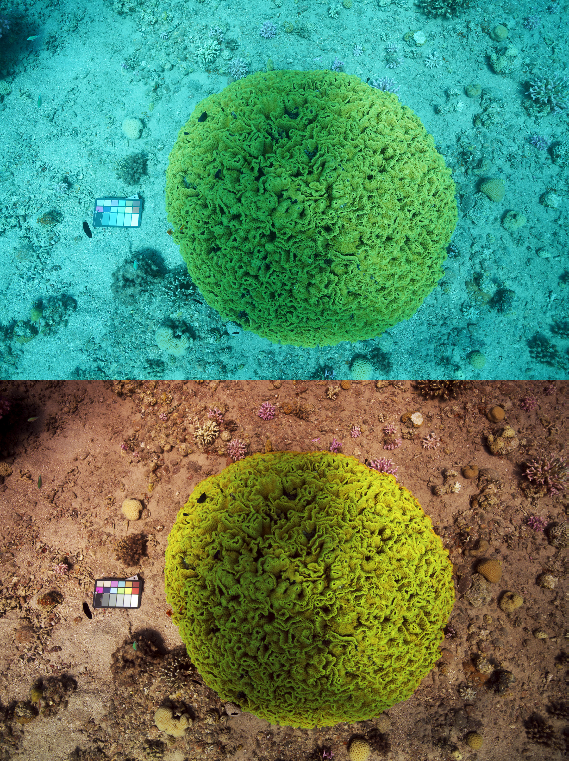
Midterm Presentation Color restoration of underwater images
Students: Ofer Hazut, Amir Saad
Supervisor: Tali Treibitz PhD
Context: Project B
Semester: Spring, 2019
Date: Dec 2019

Slide 2
Presentation Outline
In this slide you put the general outline of the coming presentation

Slide 3
Project Goal
Describe the general goal of the project: what is the problem you face and what you want to achieve

Slide 4
Background
A general description of background, e.g. the environment, existing system, solutions etc.

Slide 5
Optional Solutions
Describe in more details existing relevant solution(s) for the problem – general description, algorithms, systems, pro’s Vs. Con’s (quality, cost, complexity…) etc.

Slide 6
Chosen solution: Block Diagram
A detailed explanation about the chosen solution – a block diagram is a very good way to start with, probably followed with a few more slides describing the solution and maybe more diagrams for details if needed

Slide 7
Chosen solution: details
Explanations of the solution and the block diagram from the previous slide –

Slide 8
Results
Present your results – the output of your system with comparison to other systems so you can show what you do better than others

Slide 9
Summary
A short summary of the work – main points in the implementation , achievements, original contribution etc.

Slide 10
Conclusions
Explain in short what can be learned from your results, future work you think can be done etc.

Slide 11
References
Only most important references should be mentioned here, in the following form:
[#] Author name(s), Title, Publisher (conference/Magazine) , Year

